Slide 1
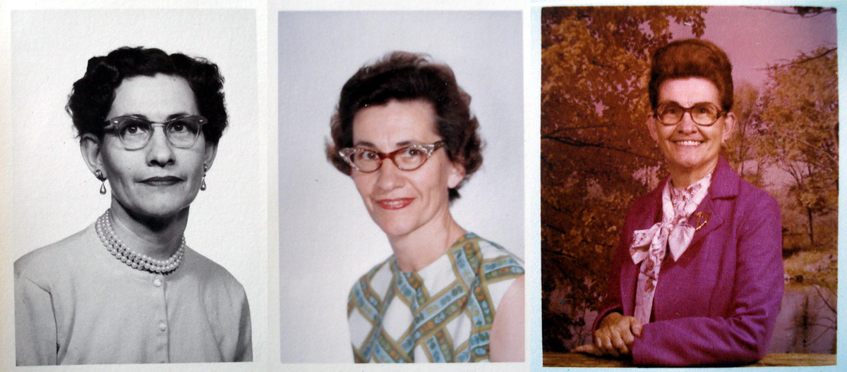

Aging
[Professor Name]
[Class Section Number]
Notes:
This module describes central concepts and research about adult development and aging. Discussed here are contemporary questions about cognitive aging and changes in personality, self-related beliefs, social relations. Aging is optimally taught over one long class period and can be largely activity driven. The lecture will tie in to the activity discussion so you can organize the discussion to mirror the lecture slides and refer to the activity throughout the class. You also have the option to do a shorter activity time and then follow with a traditional lecture rather than weaving the two together.
Warmup Questions: What are some common attitudes or preconceptions about “old people”? What are some characteristics by which we define someone as “old”? How does their behavior differ from that of children?
Explanation: By 2030, when the last of the Baby Boomers reach age 65, the U.S. older population will be twice that of 2010. Furthermore, due to increases in average life expectancy, each successive generation can expect to live longer than their parents’ generation and certainly longer than their grandparents’ generation. Considering the approaching reality of prolonged “old age”, the implications of understanding aging take on a pronounced significance.
Optional Activity: Before class, have students survey friends for the first three words or phrases that come to mind when they hear the word “elderly”. Have them record the age and gender of their participants. Prepare a master list, ordered from most common to least common. (Alternately, you might administer a written poll to the students then write their answers on the board.)
hips, and subjective well-being.

Slide 2
Overview
Introduction
Cognitive Aging
Personality and Self-related Processes
Relationships
Emotions and Well-being
Longevity
Notes:
The purpose of this slide is to provide students with an overview of the material that will be covered during the lecture.
Technical Note: These slides may contain simple click animation so that you can focus students’ attention on a particular question, a selection of text, or an image and not have them be distracted by reading ahead. You can either preview the sequence of animation by going through the slides in slideshow view, visiting the animations tab, or reviewing the slide notes. In the notes you will see a cue - (Click) – that corresponds to each animation.
You will also find hyperlinks to outside videos at various places in the slides. These hyperlinks are embedded in text and indicated by color and in the notes section.

Slide 3
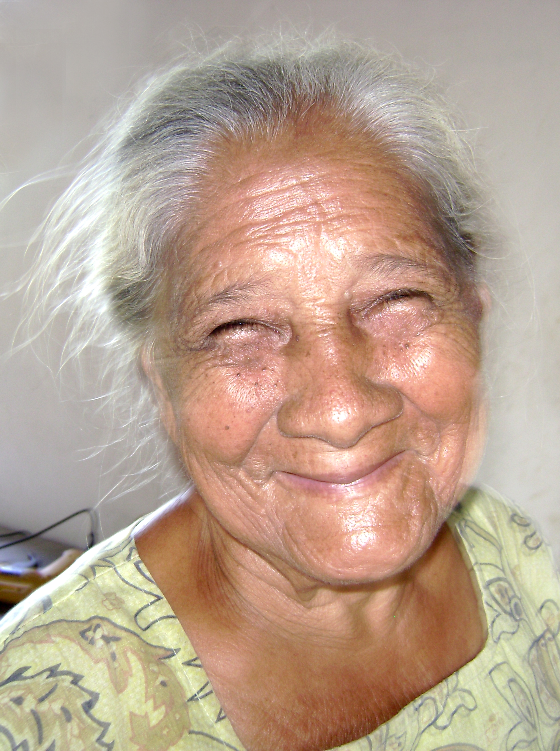
Introduction
The growing importance of understanding aging
What would you need to be happy at age 80?
How will you get what you need?
Notes:
This slide introduces and orients students to the topic of aging by encouraging them to think about their future.
(Click) Discussion Question: What do you think you will need to be happy at age 80?
Elicit answers from the students and write them on the board.
(Click) Discussion Questions: How will you get what you need, realistically? How do your opportunities compare with those your parents had?
Elicit answers from the students and write them on the board.
Explanation: This will get students thinking about the personal implications of the aging process, providing an opportunity for discussion about the students’ attitudes and values as they imagine them over the long term, and how they might personally affect the outcome.

Slide 4
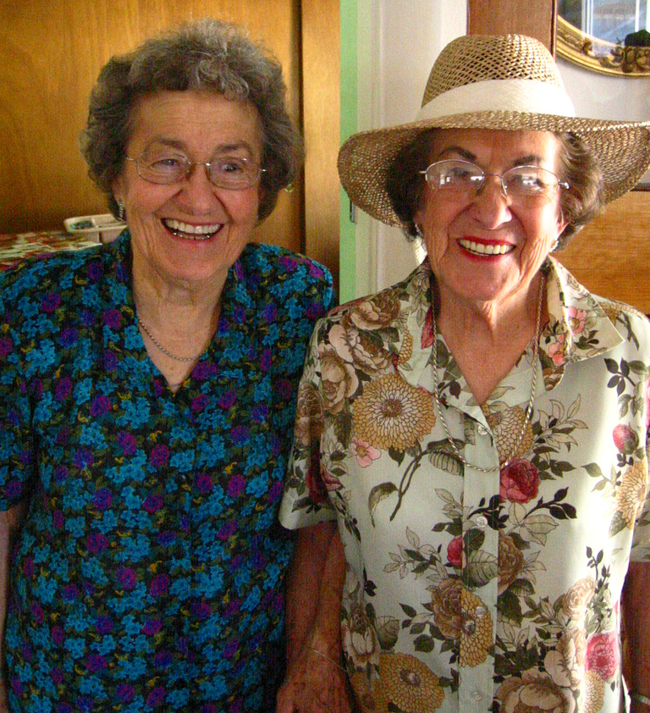
Perspectives on Aging
Heterogeneity
Life course theories
Social expectations
Normative timing
Life span theories
Individual differences
Change
Notes:
This slide introduces life span and life course perspectives on aging.
Explanation: Just as in young adulthood, there is substantial heterogeneity (or differences) between older individuals. This heterogeneity reflects differences in rates of biogenetic and psychological aging and the sociocultural contexts and history of people's lives. Theories of aging describe how these multiple factors interact and change over time. They describe why functioning differs on average between young, middle-aged, young-old, and very old adults and why there is heterogeneity within these age groups.
Discussion Topic: What are some of the ways the process of aging differs between individuals? Theories on aging present ways of examining these differences.
(Click) Life course theories
Life course theories highlight the effects of
(Click) social expectations, and the
(Click) normative timing of life events and social roles (e.g., becoming a parent, retirement).
They also consider the lifelong cumulative effects of membership in specific cohorts (generations), sociocultural subgroups (e.g., race, gender, socioeconomic status), and exposure to historical events (e.g., war, revolution, natural disasters).
(Click) Life span theories
Life span theories complement the life course perspective with a greater focus on
(Click) processes within the individual (e.g., the aging brain).
(Click) This approach emphasizes the patterning of lifelong intra- (within) and inter- (between) individual differences in the shape (gain, maintenance, loss), level, and rate of change.

Slide 5
Overview
Introduction
Cognitive Aging
Personality and Self-related Processes
Relationships
Emotions and Well-being
Longevity
Notes:
The purpose of this slide is to provide an overview of the material that will be covered in the lecture.

Slide 6
Cognitive Aging
Decreases
Fluid Intelligence
Recall of Information
Working Memory
Processing Speed
Inhibitory Functioning
Vision
Hearing
Increases
Crystallized Intelligence
Greater Cognitive Efficiency
Remains the same
Recognition
Notes:
This slide illustrates changes in cognitive abilities with age. Note that, though cognitive abilities decrease overall, not all decrease.
(Click) Decreases
Fluid Intelligence refers to information processing abilities, such as logical reasoning, remembering lists, spatial ability, and reaction time.
Recall of information refers to individuals’ ability to remember details without the help of a list of possible choices.
Working memory refers to the ability to simultaneously store and use information.
Processing speed refers to the speed of general cognitive performance (though not efficiency).
Inhibitory functioning refers to the ability to focus and prioritize attention to information.
Vision and Hearing senses also decrease with age.
(Click) Increases
Crystallized intelligence (“Wisdom”) encompasses abilities that draw upon experience and knowledge; older people have accumulated more life experiences, so they have more to draw on. Measures of crystallized intelligence include vocabulary tests, solving number problems, and understanding texts.
Greater cognitive efficiency refers to a better grasp of probable outcomes. For example, older chess experts are able to focus on a smaller set of possible moves than young chess players.
(Click) Remains the same
Recognition refers to individuals’ ability to remember information with the assistance of cues.
Explanation: While older adults have more years of experience, cognitive declines related to reaction time or attentional processes may pose limitations under certain circumstances (e.g., driving). However, older adults also demonstrate more effective strategies than younger adults to navigate through social and emotional problems. It is important to note, that despite cognitive changes, no differences in work performance have been found – this may be due to an individuals ability to adapt to and compensate for cognitive changes.

Slide 7
Overview
Introduction
Cognitive Aging
Personality and Self-related Processes
Relationships
Emotions and Well-being
Longevity
Notes:
The purpose of this slide is to provide an overview of the material that will be covered in the lecture.

Slide 8
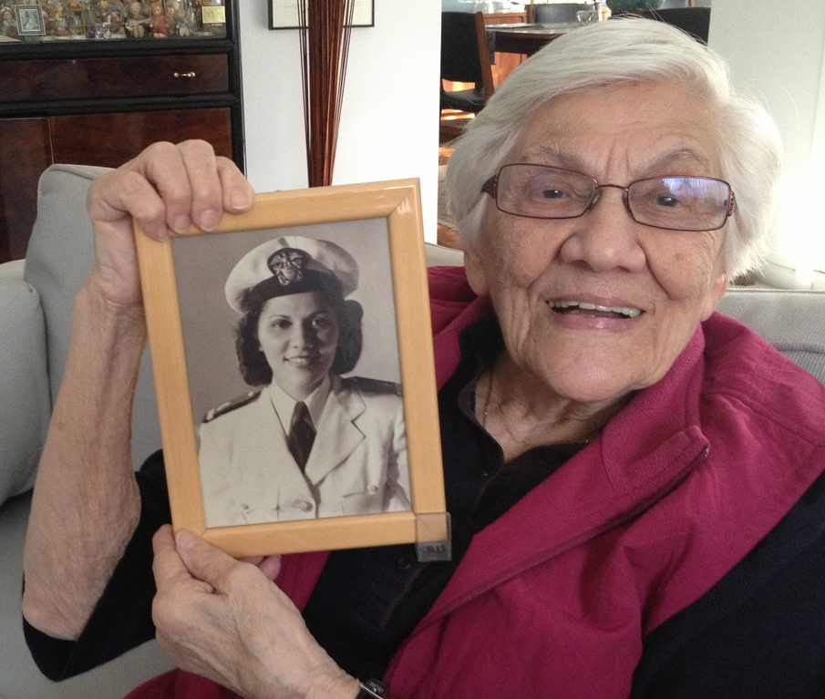
Personality & Self-Related Processes
Personality development
Finding meaning
Young at heart
Notes:
This slide discusses differences in personality, describes important tasks of late adulthood, and discusses beliefs and perceptions of one’s aging process.
Discussion Questions: Are we the same person all our life? How do we derive meaning from growing old? How does growing old affect our identity and concepts of self-worth?
(Click) Personality development
In the past, the general consensus was that personalities don’t change much throughout life, but research has demonstrated otherwise. Some people’s personalities remain relatively stable, but others’ change. Longitudinal studies reveal average changes during adulthood in the expression of some traits (e.g., neuroticism and openness decrease with age, while conscientiousness increases) and individual changes due to idiosyncratic life events (e.g., divorce, illness). Moreover, some personality traits, such as conscientiousness, predict important life outcomes, including job success, health, and longevity, which then in turn further affects personality.
(Click) Finding meaning
Often one’s values depend on the stage of life one is in. This is studied by conducting autobiographical narratives with individuals at all developmental stages. Late adulthood is often characterized by a life review and reflections about having lived a long life. Oftentimes this helps individuals confront and cope with the challenges of old age.
(Click) Young at heart
Subjective age is a multidimensional construct that indicates how old (or young) a person feels. Feeling younger and being satisfied with one’s own aging are expressions of positive self-perceptions of aging. Individuals who are able to adapt to and accept changes in their appearance Thus being young at heart may actually increase longevity.

Slide 9
Overview
Introduction
Cognitive Aging
Personality and Self-related Processes
Relationships
Emotions and Well-being
Longevity
Notes:
The purpose of this slide is to provide an overview of the material that will be covered in the lecture.

Slide 10
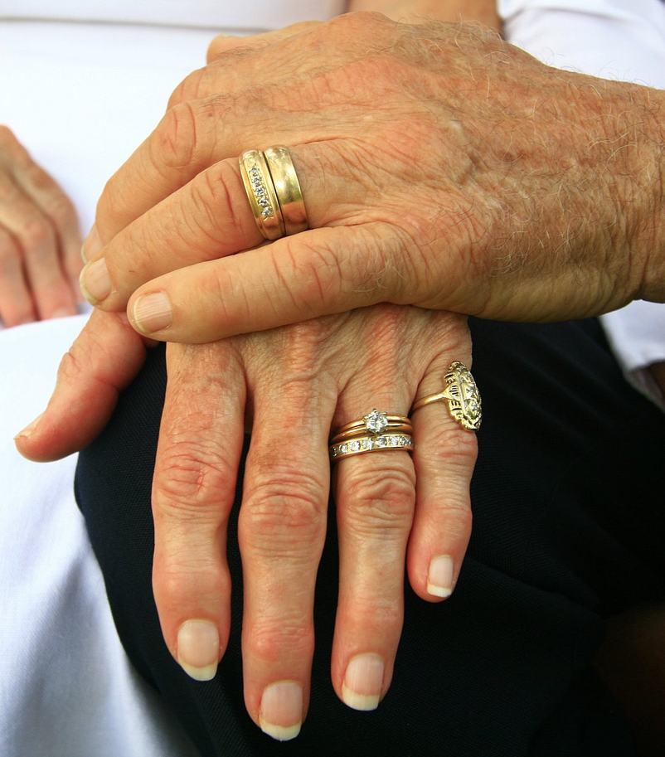
Relationships
Priorities
Convoy Model of Social Relations
Socioemotional Selectivity Theory
More positive
Less negative
Smaller support networks
Notes:
This slide describes key aspects of relationships and emotions in late adulthood, and discusses longevity.
Discussion topic: What do relationships look like as people age?
(Click) Priorities
What are some of the priorities that motivate relationships for older individuals? In other words, what do older people gain from their relationships?
Explanation:
(Click) Convoy model of social relations
The Convoy Model of Social Relations suggests that social connections are held together by exchanges in social support (e.g., tangible and emotional). The frequency, types, and reciprocity of the exchanges change in response to need, which in turn impacts the well-being of individuals in the convoy. In many relationships, it is not the actual exchange of support that is critical but instead the perception that support is available if needed.
(Click) Socioemotional Selectivity Theory
The Socioemotional Selectivity Theory focuses on motivational changes for actively seeking social contact. This theory suggests that with increasing age our relationship goals change from information gathering to emotion regulation. To optimize the experience of positive affect, older adults actively restrict their social life to prioritize time spent with emotionally close significant others.
Further Discussion topic: Do relationships among older people tend to be more emotionally positive or negative? Do they have relatively large or small social networks?
(Click) More positive
Older marriages are found to be characterized by enhanced positive and
(Click) less negative interactions, and older partners show more affectionate behavior during conflict than do middle-aged partners. Older adults tend to have better outcomes if they are married (rather than widows, divorced or single), however, this is not necessarily true if the relationship is strained or if a partner becomes a primary caregiver.
(Click) Smaller support networks
Older adults have smaller networks compared to young adults and tend to avoid negative interactions.
Note: Similar selective processes are also observed in young adults when time for social interactions shrinks temporarily (e.g., impending geographical separations).

Slide 11
Overview
Introduction
Cognitive Aging
Personality and Self-related Processes
Relationships
Emotions and Well-being
Longevity
Notes:
The purpose of this slide is to provide an overview of the material that will be covered in the lecture.

Slide 12
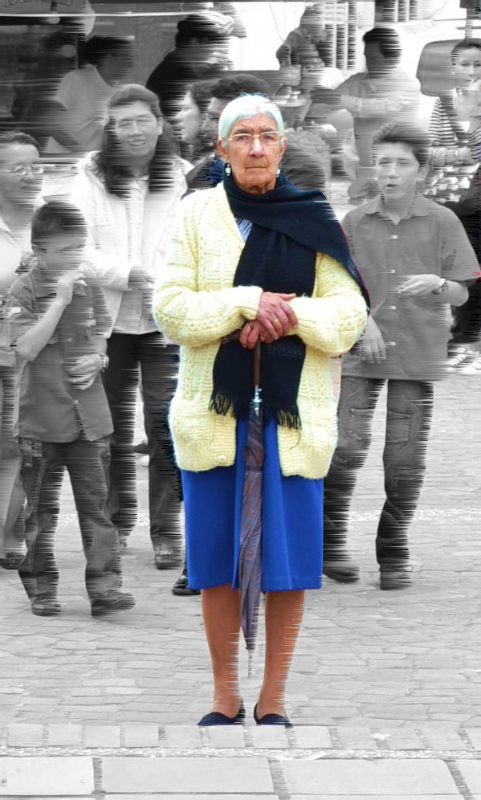
Emotion and Well-being
Emotional challenges of aging?
Psychological wellbeing
Global subjective wellbeing
Hedonic wellbeing
Notes:
This slide illustrates the emotional challenges associated with aging.
Discussion topic: Are older adults happy? How do we determine wellbeing?
(Click) Emotional challenges of aging?
Discussion Question: What are some of the emotional challenges likely to be faced by individuals in advancing age?
Answers students may generate might include poor health, losing loved ones, not working (or feeling productive), etc.
(Click) Psychological wellbeing
Explanation: Psychological well-being aims to evaluate the positive aspects of psychosocial development, as opposed to factors of ill-being, such as depression or anxiety. There are a variety of ways individuals are able to maintain emotional well-being despite challenges associated with aging. Examples include:
(Click) Global subjective wellbeing
Global subjective well-being is an individual’s overall perception of his or her life. Age, health, personality, social support, and life experiences all influence global well-being. Different life events influence well-being in different ways, and individuals do not often return to baseline levels of well-being. Events and conditions, such as unemployment or poor health, may have lasting negative impacts on well-being as people age. Research suggests that global well-being is highest in early and later adulthood and lowest in midlife.
(Click) Hedonic wellbeing
Hedonic well-being refers to the emotional component of well-being and includes measures of positive and negative affect (e.g., happiness, contentment, stress, sadness, etc.). It should be noted that both global well-being and positive affect tend to taper off during the end of older adulthood and these declines may be accounted for by increases in health-related losses during these years.
Further Explanation: Older adults tend to report higher environmental mastery (feelings of competence and control in managing everyday life) and autonomy (independence), lower personal growth and purpose in life, and similar levels of positive relations with others as younger individuals. The healthful implications of maintaining high-quality connections with others may be important for optimizing the quality of life in old age.

Slide 13
Overview
Introduction
Cognitive Aging
Personality and Self-related Processes
Relationships
Emotions and Well-being
Longevity
Notes:
The purpose of this slide is to provide an overview of the material that will be covered in the lecture.

Slide 14
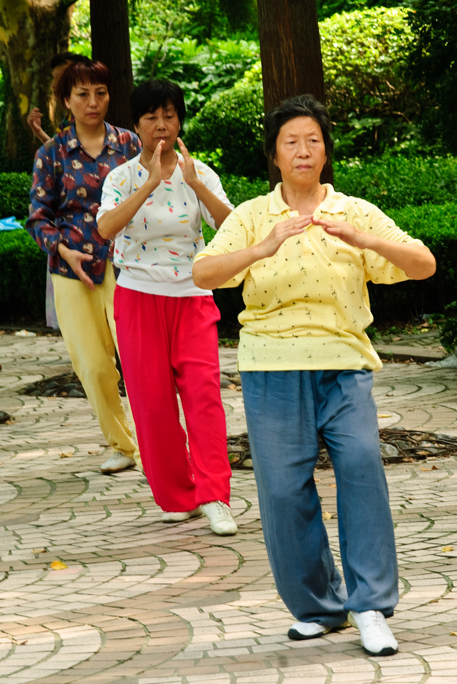
Longevity
Influences
Genes
Environmental
Successful aging
Low risk factors
Maintenance
Active engagement
Notes:
This slide describes influences on longevity and ways individuals can age successfully.
Discussion topic: What are some of the factors that contribute to longevity of life?
(Click) Influences
Two main influences that account for variations in longevity are
(Click) genes and the
(Click) environment in which an individual lives.
Research has shown the genes account only for 25% of variance in life spans.
Given the powerful impact of a person’s environment, what can be done to assist individuals with aging successfully?
Explanation:
(Click) Successful Aging
Successful aging is obtained through:
(Click) Low Risk Factors: the avoidance of disease, disability, and risk factors like high blood pressure, smoking, or obesity;
(Click) Maintenance: the maintenance of high physical and cognitive functioning through physical and mental exercise;
(Click) Active engagement: engagement in social and productive activities that keep an individual occupied and interested in life.

Slide 15
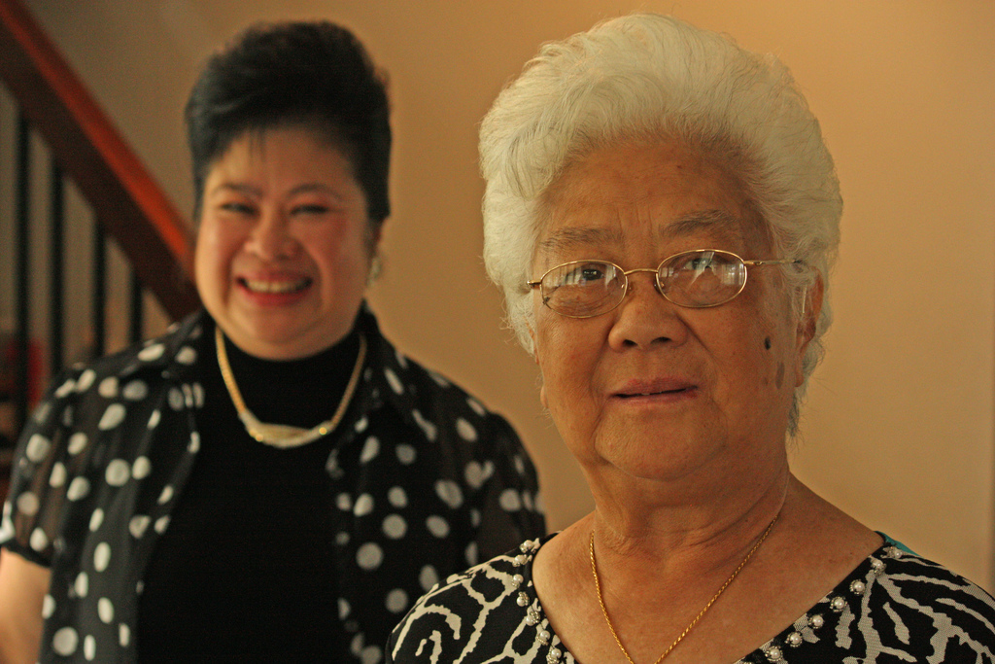
Conclusion
Notes:
Discussion/Conclusion Questions::
Go back to the activity from the beginning of class and reexamine the first three words that came to mind upon hearing the word “elderly”; Did you write down positive attributes? How have your attitudes or assumptions changed, if at all?
Further Activity: Consider the “Developmental Differences in the quality of life” activity. (For detailed instructions see IM > Unit Development > Module 3: Aging > Activities/Demonstrations.)

Slide 16
Photo Attribution
Slide 4 | Photo Credit: tenunda https://www.flickr.com/photos/21107909@N00/377121567/ https://creativecommons.org/licenses/by-nc-sa/2.0/
Slide 8 | Photo Credit: cogdogblog https://www.flickr.com/photos/37996646802@N01/8173917159/ https://creativecommons.org/licenses/by-sa/2.0/
Slide 10 | Photo Credit: what_marty_sees https://www.flickr.com/photos/14996968@N08/4812486511/ https://creativecommons.org/licenses/by-nc/2.0/
Slide 12 | Photo Credit: Lau =D https://www.flickr.com/photos/25557266@N08/5554633106/ https://creativecommons.org/licenses/by-nd/2.0/
Slide 14 | Photo Credit: thaths https://www.flickr.com/photos/34816987@N00/3805097154/ https://creativecommons.org/licenses/by-nc/2.0/
Slide 15 | Photo Credit: Lawrence OP https://www.flickr.com/photos/35409814@N00/2845631546/ https://creativecommons.org/licenses/by-nc/2.0/

